Slide 1
Tribometer Signal Processing Project
6/6/18

Slide 2
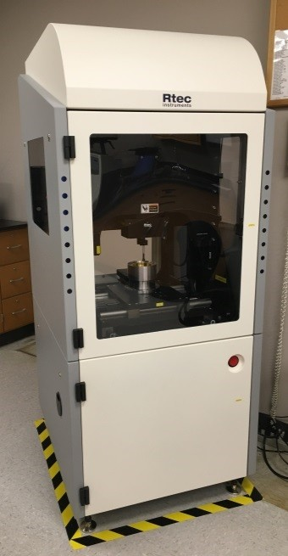
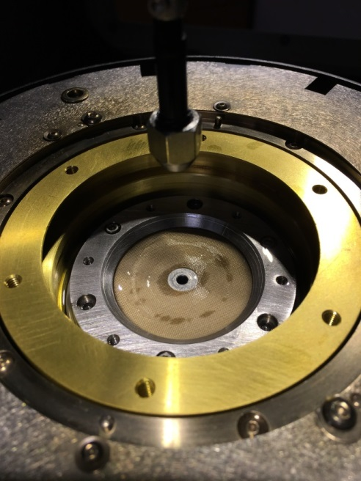
Overview of MENH Tribometer
Can quantify the frictional performance & wear behavior of virtually any AFF product
Test possibilities include:
Applied loads: 0.1 – 500 N (0.02 – 112 lbf)
Test speeds: 0.1 – 1000 mm/s
Temperatures: ambient – 500°C
Wear patterns: rotational or linear reciprocating
Wear materials: virtually anything (steel, plastic, ceramic, rubber, etc.)
Dry or lubricated surfaces (silicone oil, etc.)
Generated data includes:
Coefficient of friction (COF) vs. time, speed, & load
Wear rate (depth measured, volume calculated)
Can compare LFL performance under a wide range of conditions to determine key variables

Slide 3
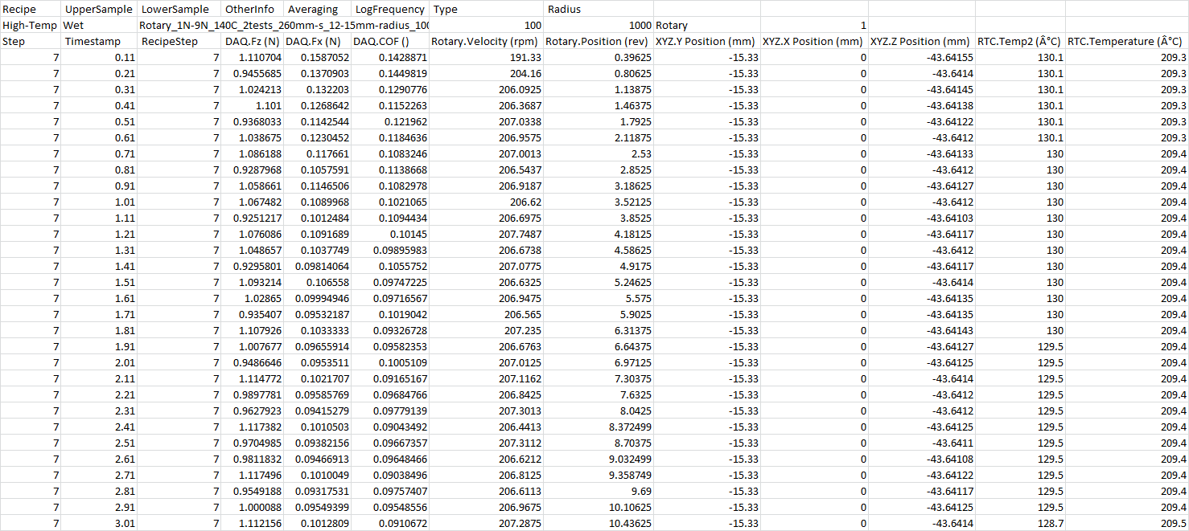
Typical Tribometer Data Output & Format
Text Values in .CSV Format

Slide 4
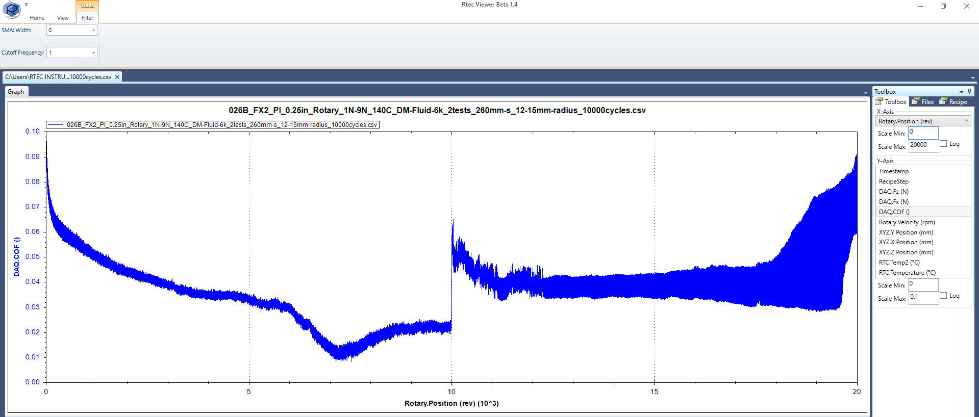
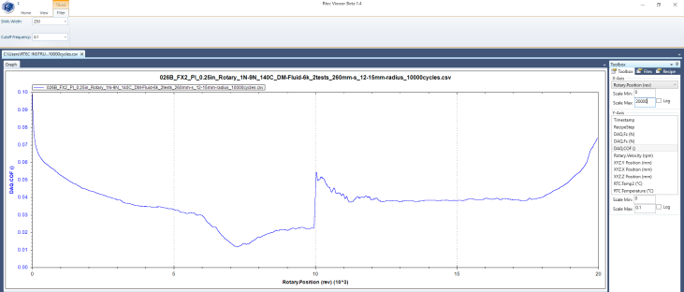
Proprietary “Rtec Viewer” Software Currently Used for Data Analysis
Plots COF & Other Outputs vs. Time or Rotations, Smooths & Frequency-Filters Data
The tribometer’s data collection frequency & data averaging are adjustable.
This data was recorded at 1000 Hz with a 100 data point average. (One data point is recorded every 0.1s and is an average of 100 measurements).
This analysis software is then used to plot data, further smooth & filter the resulting curves, and compare samples.
Raw COF vs. Wear Rotations Data
Same Data after SMA Smoothing (Width = 250) & Frequency Filtering (0.1 Hz Cutoff)

Slide 5
Current Limitations & Goals of Signal Processing Project
Desired Output: A Processed .CSV File with the Following Modifications
It is preferable to plot COF data versus wear rotations instead of time, but the tribometer does not reset rotations in between samples and only starts at 0 when the software is fully rebooted. This requires manually adjusting the initial rotary position of each sample to 0 in order to plot different samples on the same axis.
Design a script to automate this process. Set the initial “rotary.position” value of each program step to 0 and increment each successive data point by the correct amount until the final data point for that step.
To mitigate sample-to-sample variability, most tests are performed in replicate. However, averaging the data output of these replicate tests is currently done manually.
Design a script to automate this process. Take 2 or more data sets and average their “timestamp,” “DAQ.COF,” & “rotary.position” values for each step.
Build in functionality to choose which steps of each data set should be averaged. For example, we may wish to average the “step 7” data from file #1 with the “step 12” data from file #2.
If possible, build in functionality to average data sets that were not collected using the same data collection frequency. For example, average file #1 that contains data collected every 0.1 seconds with file #2 that contains data collected every 0.5 seconds (this may require omitting intermittent data points from the higher-frequency data set).
The SMA smoothing & frequency filtering aspects of the Rtec Viewer software are desirable, but there is no way to save that processed data, save the plots, or plot the processed data using another program like Excel.
Design a script to optionally perform SMA smoothing (and, if possible), frequency filtering on selected data sets and save the processed values.
Build in functionality to select the SMA width & frequency cutoff just as is done in the Rtec Viewer software.
Many important test variables are not currently recorded in the tribometer’s data output file and must be recorded elsewhere. These include: sample name, wear material, wear ball diameter, lubricant used (if any), and a description/general comments field.
Design a script to optionally record & include this additional information of the heading of the processed .CSV file.

Slide 6
Current Limitations & Goals of Signal Processing Project (cont.)
Stretch Goals
The Rtec Viewer software only plots primary data values & does not have the ability to look at the derivatives of the plotted curves.
Design a script to take the derivative of a file’s “DAQ.COF” values as a function of its “rotary.position” or (optionally) “timestamp” values and output the data in a new column. This will allow us to inspect the rate of change of COF values, and inflection points in these derivate curves may indicate when a product has reached a certain “end-of-life” amount of wear.
If possible, design a user-friendly database (or library file) of uploaded data sets which allow rapid comparison & plotting of different samples under adjustable conditions including: x-axis variable, multi-axis y variables, axis limits, sample/legend names, and plot color.
If possible, allow the chosen plots to be saved so that they may be re-opened & further manipulated at a later date.

